Slide 1

Decisions, Testing & Validation
From Outcome to Confidence – Interpreting Results & Ensuring Quality
Presented by: Treveshan Naidoo
TTD Consulting Internal Learning Series

Slide 2
Welcome
This week, we go from rule results → decisions
Then we move into testing and validation
Today is all about trusting your rule engine
Notes:
We’re combining two crucial topics today. First, how to make meaningful business decisions from rule outcomes. Then, we’ll ensure those outcomes are correct through unit testing and validation.

Slide 3
Business Outcomes, Not Just Rule Results
Rule results are technical (true/false, messages)
But business needs clear outcomes :
Approve
Refer
Reject
Notes:
Just saying ‘3 rules passed’ is meaningless to a business user. We need to interpret the result — can we approve the person, or escalate for review, or outright reject?

Slide 4
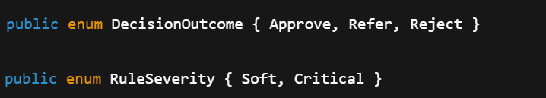
Define Decision Outcome & Rule Severity
Notes:
We’re formalizing this. DecisionOutcome tells us what action to take. RuleSeverity adds context to each rule soft failures may be tolerated, critical ones may not.

Slide 5
Mapping Rule Logs to Decisions
Condition | Outcome
All rules passed | Approve
Some soft rules failed | Refer
Any critical rule failed | Reject
Notes:
This is our mapping logic. We’ll feed the logs into a resolver class that applies this logic.

Slide 6
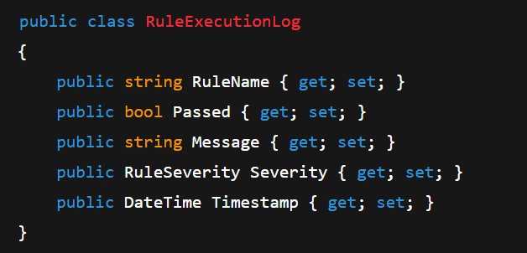
RuleExecutionLog
Notes:
We add severity here so the outcome resolver knows which failures are critical. This log is also perfect for audits.

Slide 7
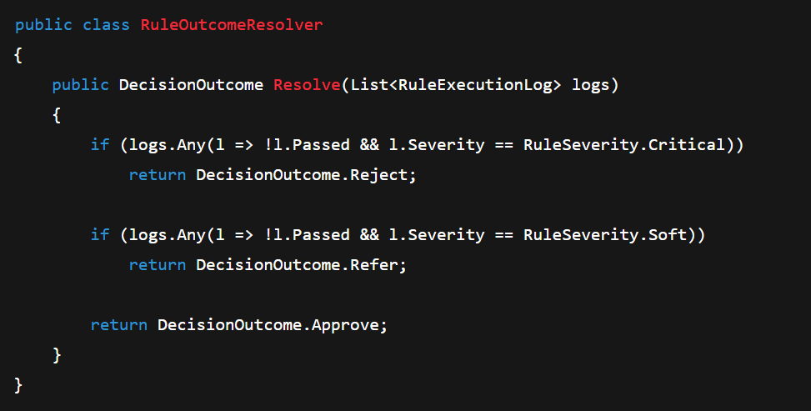
RuleOutcomeResolver
Notes:
This class abstracts the logic of turning low-level failures into meaningful outcomes. You can swap this easily if business needs change.

Slide 8
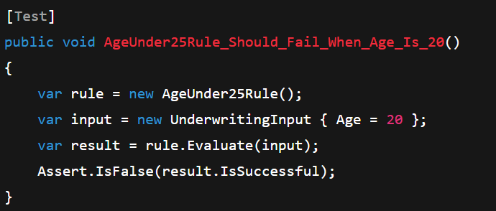
Unit Testing Rules
Notes:
Test the logic of each rule in isolation. You can do this with any test framework — we’re using NUnit here.

Slide 9
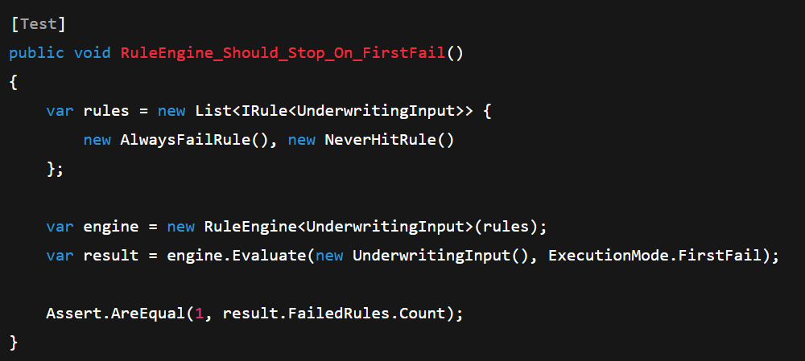
Testing the RuleEngine
Notes:
Test the behavior of the engine, especially when using different execution modes. In this case, we expect it to stop after the first failure.

Slide 10
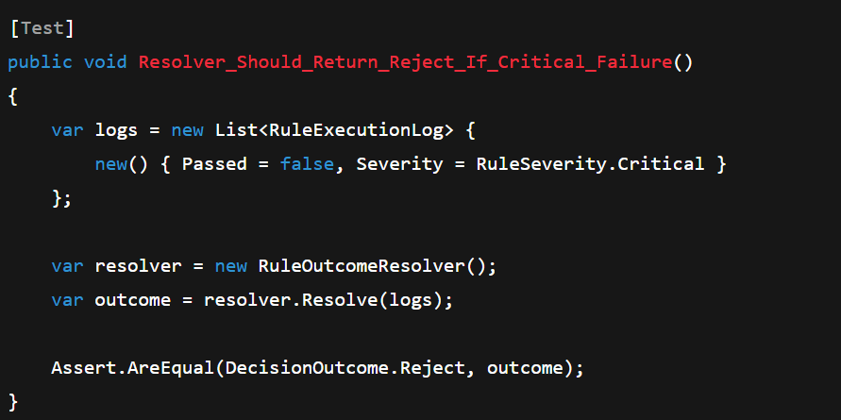
Testing the Resolver
Notes:
Just like the engine and rules, we need confidence in the resolver logic. This test proves that critical failures lead to rejection

Slide 11
Validating JSON Rules
Notes:
Don’t blindly trust external JSON. Validate each rule’s field, type, and operator before using it. This protects against config errors or security issues

Slide 12
Outcome of Today’s Session
Created DecisionOutcome layer
Attached severity to rules
Resolved business decisions from rule logs
Wrote unit tests for: Rules ,Engine ,Resolver
Validated external JSON inputs
Notes:
If you want to take it further, these are great next steps especially for real-world integration and traceability.

Slide 13
Optional Stretch Goals
Add score-based decision thresholds
Log final DecisionOutcome to DB or audit trail
Build a rule validation report for JSON config
Add an integration test that runs full scenarios
Notes:
If you want to take it further, these are great next steps especially for real-world integration and traceability.

Slide 14
Thank You
Congrats on reaching Week 5!
Next step: rule grouping, composite logic, and real-world scenarios
Open discussion: how confident are you in using this for approvals, scoring, or escalation?

